Slide 1
presentation MASTER THESIS Accelerating dose calculations in carbon ion therapy using a Wasserstein GAN
Pichaya Tappayuthpijarn
Biomedical Engineering, 5055625
"Metrology for Artificial Intelligence in Medicine" (M4AIM), Physikalisch-Technische Bundesanstalt (PTB) Berlin
Notes:
This is a presentation of my master thesis “Accelerating dose calculations in carbon ion therapy using a Wasserstein GAN” The project started in May2023 at PTB Berlin in Metrology for Artificial Intelligence in Medicine group (M4AIM)

Slide 2
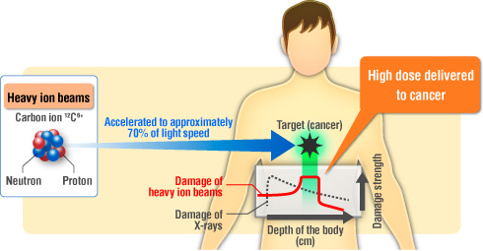
Aim of the Project
Carbon ion beam therapy
Monte Carlo simulation
simulating a large number of interactions to provide
accurate estimates of the radiation dose
Deep learning algorithms
To develop, train and test a WGAN for faster calculation of dose distribution in carbon ion radiation therapy
https://www.particle.or.jp/hirtjapan/en/what
Figure 1 Carbon ion beam characteristic
Notes:
-Carbon ion beam therapy is a type of radiation therapy that uses beams of carbon ions to treat cancer. It is attractive for cancer treatment.
It has high energy transfer and Bragg peak, allowing for precise targeting of the tumor,
Dose distribution prediction is currently done in treatment planning systems that simulate the delivery of radiation using Monte Carlo (MC) simulation, Which is very time-consuming
Recently, deep learning algorithms have been used for fast and accurate prediction of the dose distribution. The improvement will lead to better outcomes for patients.

Slide 3
Related works
Various related works in the field of dose computation for radiotherapy used GANs
(Sarrut et al., 2019) utilized a compact GAN to model large phase space files in Monte Carlo simulations. The GAN-generated 3D energy distributions closely resembling reference ones.
(Kearney et al., 2020) DoseGAN as dose prediction algorithm. It incorporates image-level loss and is better suited to learn from heterogeneous labels.
no depth-dose curves shown.
(Mentzel et al., 2022) GAN as a proof-of-concept to predict dose in simplified irradiation scenarios, as well as a pediatric head phantom.
no real irradiation scenarios
use of a broad beam instead of a microbeam
None of the above studies explored the application of carbon ion particles.
Notes:
Various related works in the field of dose computation for radiotherapy used GANs to predict radiation dose
(Kearney et al., 2020) propose DoseGAN as dose prediction algorithm., However, there was no depth-dose curves shown to compare the prediction with the MC simulation.
The recent study by (Mentzel et al., 2022) employed a GAN as a proof-of-concept to predict dose in simplified irradiation scenarios involving a water phantom with a rotating bone slab and varying thickness, as well as a pediatric head phantom. However, the use of a broad beam instead of a microbeam and the absence of real irradiation scenarios raise questions about the model's performance in more complex and realistic settings. Moreover, none of the above studies explored the application of carbon ion particles.

Slide 4
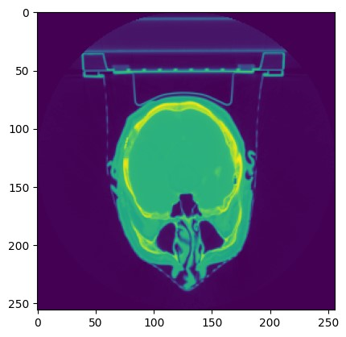
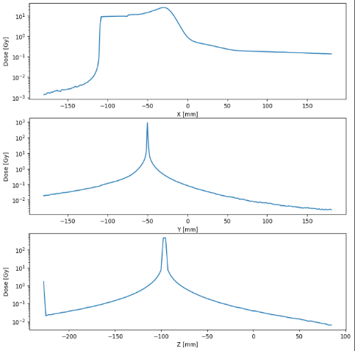

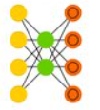






Workflow
1. Get data ready
Normalize
Resize
Turn into tensor
2. Build model
Pick a loss function
Pick optimizers
Build a training loop
Build a validation loop
3. Fit the model to data
Make predictions
4. Evaluate the model
Loss
Passing rate
5. Improve through experimentation
Hyperparameter tunning : Learning rate, batch size, etc.
6. Save and reload the model
Choose the model with lowest MSE
MSE
torch.nn
torch.nn.module
torchvision.models
torch.util.data.Dataset
torch.utils.data.DataLoader
Train Critic
Train Generator
Update Optimizer
torch.utils.tensorboard
torch.optim.Adam
Figure 2 Steps in the ML model development process
Notes:
Workflow of Investigating model training strategies and optimization of the network.
I utilize Pytorch framwork for this project and the workflow is as shown here.
First get the data ready. It is most important to understand well the dataset and get the data in the right format for machine learning model. Next, I built the model, define loss function and optimizers. Then defined training loop of critic and generator. After fitting the model and make predictions, the model performance was evaluated by loss , passing rate and Mean square error.
The model was improved through experimentation. Lastly the best model can be saved and loaded for making prediction.

Slide 5
Dataset
Dataset ‘MC Simulation of a therapeutic carbon ion beam in head’ by (Schwarze, 2023)
Based on 'Glioma Image Segmentation for Radiotherapy: RT targets, barriers to cancer spread, and organs at risk (GLIS-RT)’ (Shusharina & Bortfeld, 2021)
Monte-Carlo radiation transport simulation using Geant4 (Agostinelli et al., 2003)
30 source positions per beam energy: 1250, 1375, 1500, … , 3000 (MeV)
Energy depositions of a beam within
Head phantom : CT images of various patients with a brain tumor.
Pure water phantom
Notes:
The dataset was already available and provided. It was produced based GLIS-RT which are CT images of the head and neck region of various patients with a brain tumor.
Monte-Carlo radiation transport simulations were performed using the simulation software Geant4 (Agostinelli et al., 2003) to calculate dose distributions.

Slide 6
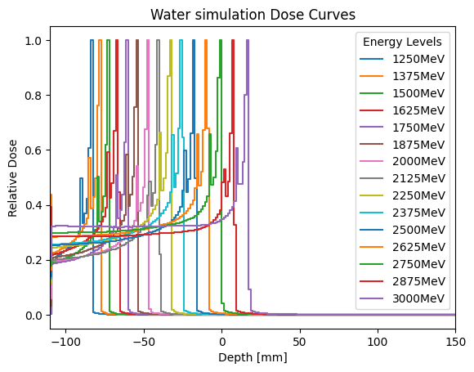
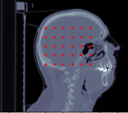
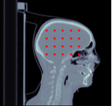
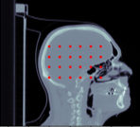
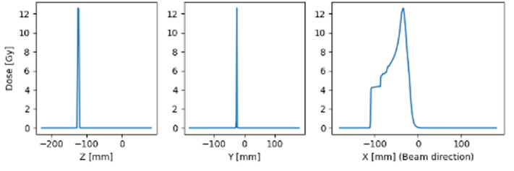
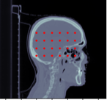
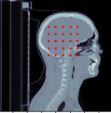
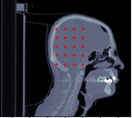
Dataset
Energy deposition in brain phantom
2) DICOM image of the head
3D density matrix
3) Energy deposition in water phantom
csv Data [X,Y,Z,Energy value]
0 1.42153e-09
2 4.83688e-10
3 7.79105e-09
4 2.0861e-07
Dataset # : simulations
Dataset 1: 450
Dataset 2: 375
Dataset 4: 360
Figure 3 Profiles of the calculated dose distribution of carbon ion in the head along three directions
Dataset 5: 360
Dataset 7: 300
Dataset 8: 300
Figure 4 Beam source positions of each dataset
Figure 5 Profiles of the calculated dose distribution of carbon ion in water
Notes:
The output of the MC simulation was organized as list files containing lines with [voxel index, dose value] voxel index encodes the x, y, z coordinates. To match a voxel grid system, the data required transformation to convert the energy deposition into 3D dose distribution.
2) There were 6 patient datasets available for the project and each has a different number of voxels and different source locations to provide geometric variety.
3) Energy deposition in water phantom was simulated and saved as raw csv data. The simulation output was processed to convert the raw simulation data into a three-dimensional dose map. The dose calculation was done for each carbon ion energy in the dataset…..

Slide 7
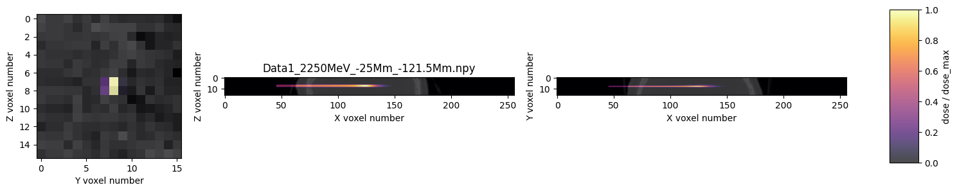

Data preprocessing
Convert raw data into a 3D Numpy array
Resampling :SimpleITK library (https://simpleitk.org/)
Cropping datasets to focus on a specific region of interest (16*16*256)
Shuffle and split data
Train subset - 70%
Validation subset - 15%
Test subset - 15%
Create custom dataset and Dataloader
Augmentation
Normalization with min-max scaling to range [0,1]
Transform to tensor
DataLoader to load as batch to GPU
Figure 6 Samples from different datasets compared with their respective doses in the water.
Notes:
Resampling = ensure their consistency in terms of voxel size and range.
The next step involved cropping the data to precisely determine the beam center. It was mainly driven by the goal to optimize efficiency and reduce computational resource demands.
….
Finally, to optimize GPU utilization, a DataLoader was employed to load the data in batches of 32 samples.

Slide 8
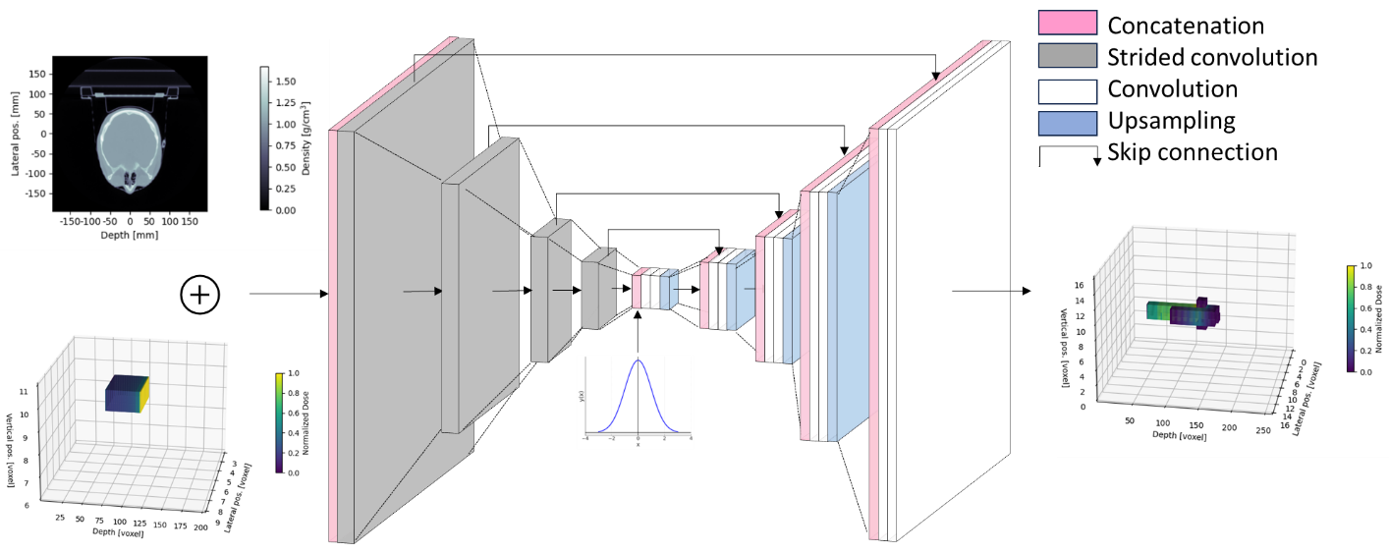
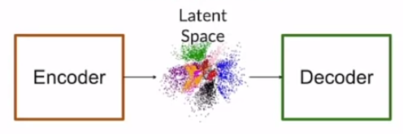
Generator : 3D-UNet architecture
Figure 7 The generator model architecture adapted from (Mentzel et al., 2022).
Notes:
architecture of generator is a type of convolutional neural network (CNN) that is designed for 3D image segmentation tasks.
It is composed of
encoder network that extracts features from the input 3D image,
a decoder network
skip connections that allow the network to preserve spatial information.
the generator network takes both a random noise vector and a conditional input. The conditional input provides additional information to the generator
output = 3D matrix of dose map of specific size

Slide 9
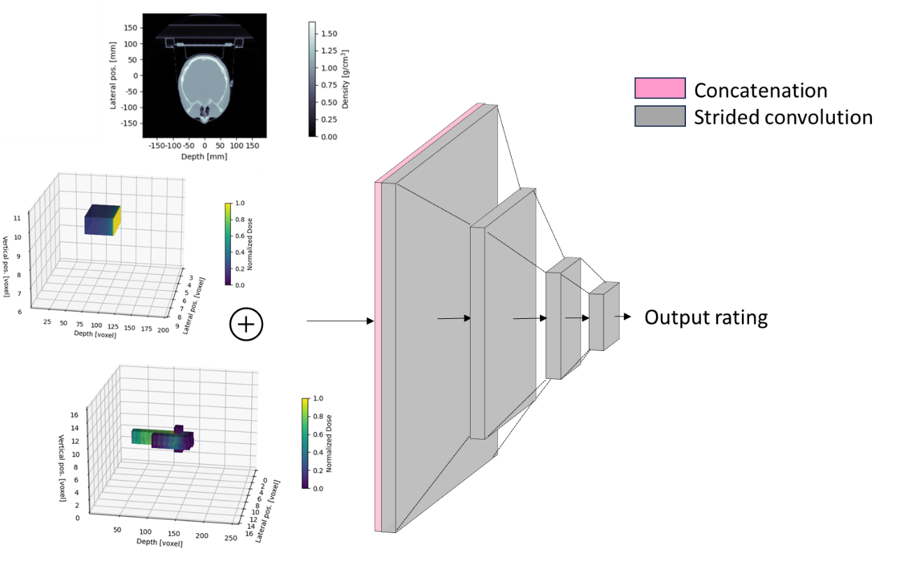
Critic : Convolutional Neural Network
Figure 8 Critic model architecture adapted from (Mentzel et al., 2022).
Notes:
It is a relatively simple 3D convolutional network. The critic network receives both the generated images and the corresponding conditional input
The three input matrices are concatenated and passed through consecutive 3D convolutions of decreasing ﬁlter size
The last single linear unit gives a continuous and quantitative rating, which distinguishes simulated from generated samples

Slide 10
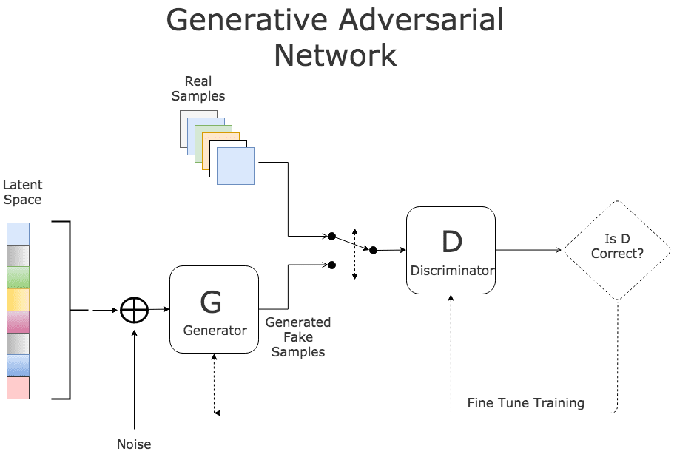
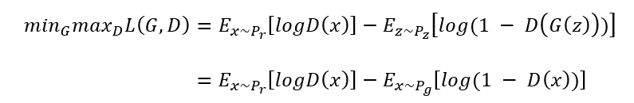
Generative Adversarial Network (GAN)
(Goodfellow et al., 2014)
Kullback-Leibler (KL), Jensen-Shannon (JS) divergene
Optimize the loss function (Based on BCE function )
Eq. 1
Limitations of normal GAN:
- mode collapse , vanishing gradient , non-convergence
(Arjovsky & Bottou, 2017)
Figure 9 Architecture of a generative adversarial network. (Image source: KDNuggets).
Notes:
two primary components: the generator (G) and the discriminator (D) which are trained in a game-like fashion.
The loss function is based on Binary Cross Entropy function,BCE loss. It is optimized so that On one hand, discriminator to maximiz this term. On the other hand, the generator is trained to minimize it.
( NOTE: First term associating with x coming from the True probability distribution. The loss is 0 when the prediction is close to real label and minus infinity when it is predicting otherwise. The second term is related when the it is fake (x from Pg) but it classified as real so will give minus infinity)
Limitation …
mode collapse = the generator can produce less variety of images because it learns that it can get high score for some of the images.
Vanishing gradient occurs when $p_{r}$ and $p_{g}$ are disjoint. If the discriminator is perfect, the gradient of the loss function approaches zero. There is no gradient to update the loss during training iterations.
when the discriminator performs poorly, the generator lacks precise feedback, leading to a loss function that fails to accurately represent reality.
The main reason behind non-convergence is that the divergence used by the classic GAN doesn't account for "distance"
This is why it is difficult to get the meaningful gradient when the G is very bad. Because the gradient should tell you to move closer to the real probability distribution but it does ‘t know that information.

Slide 11



Wasserstein GAN (WGAN)
(Arjovsky et al., 2017)
Wasserstein loss Function :Earth-Mover’s distance
$$W\left(P_{r},P_{g}\right)=\inf_{γ∈Π\left(P_{r},P_{g}\right)}{E_{\left(x,y\right)∼γ}}\left[\left|x−y\right|\right]$$
Eq. 2
Implementation:
Weight clipping (Arjovsky et al., 2017)
Gradient penalty (Gulrajani et al., 2017)
Transformation of the formula using Kantorovich-Rubinstein duality :
$$W\left(P_{r},P_{g}\right)=\inf_{γ∈Π\left(P_{r},P_{g}\right)}{E_{\left(x,y\right)∼γ}}\left[f\left(x\right)−f\left(y\right)\right]$$
Eq. 3
f is 1-Lipschitz continuous.
The WGAN value function in terms of the generator $G$ and the critic $D$ of the GAN :
$$V\left(G,D\right)=E_{x∼p_{r}}\left[D\left(x\right)\right]−E_{z∼p_{z}}\left[D\left(G\left(z\right)\right)\right]$$
Eq. 4
Generator loss:
Critic loss:
Eq. 5
$${ L}_{g} =−E_{\tilde{x}∼p_{g}}\left[D\left(\tilde{x}\right)\right]$$
Eq. 6
$$L_{c}=E\left[D\left(x\right)\right]−E_{\tilde{x}∼p_{g}}\left[D\left(\tilde{x}\right)\right]+λ E_{\hat{x}∼p_{\hat{x}}}\left[{\left({\left|∇_{\hat{x}}D\left(\hat{x}\right)\right|}_{2}−1\right)}^{2}\right]$$
Notes:
WGAN extends traditional GANs by employing the Wasserstein distance as the loss function instead
Earth mover's distance can tells how far we must go to transport points from one distribution to another. . However, exploring all potential joint distributions to compute the distance is impractical. Therefore, (Arjovsky) suggest a transformation of the formula using Kantorovich-Rubinstein duality to derive the WGAN value function
Finally, we take the minimum one among the costs of all moving solutions as the EM distance.
How to implement it?. We want the function’s rate of change to be bounded to grow linearly. This will increase the stability.
Weight clipping = Clip the weight of the discriminator
gradient penalty (GP) to regularize and stabilize the weight updates.
We can express Eq.3 in terms of the generator $G$ and the critic $D$ of the GAN. where $z$ is drawn from a noise distribution. The WGAN value function is then defined as Eq.4
The generator aims to minimize the value function in Eq. 4. Its goal is to produce data that receives a high score from the critic or is considered real.
Critic loss: With the gradient penalty term added, we train the critic to minimize the following function (The intuitive of gradient penalty is that it ensures the norm of the gradient or slope to be at most 1 for every point. )
In practice, the training of the Wasserstein GAN involves alternating between updating the critic and updating the generator. The critic is trained more times in each iteration to ensure a good approximation of the Wasserstein distance. The generator is then updated based on the current critic.

Slide 12
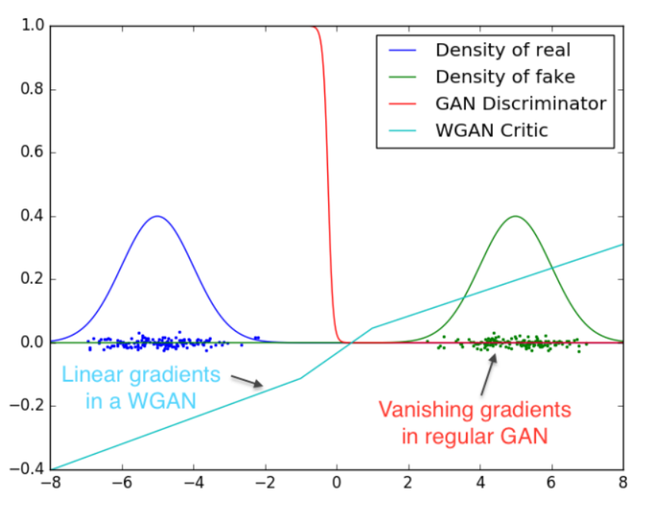
WGAN Benefits
A meaningful loss metric
Improved stability of the optimization process
Figure 10 Output of GAN discriminator compared with WGAN critic (Arjovsky & Bottou, 2017)
Notes:
As we can see, the discriminator of a classic GAN saturates and results in vanishing gradients. On the other hand WGAN critic provides very clean gradients on all parts of the space.
It does not limit the output to be between 0 and1
Thus it is not a direct critic of telling the fake samples apart from the real ones anymore. . Instead, it is trained to learn a function to help compute Wasserstein distance.
Two main benefits:
a meaningful loss metric that correlates with the generator's convergence
improved stability of the optimization process

Slide 13
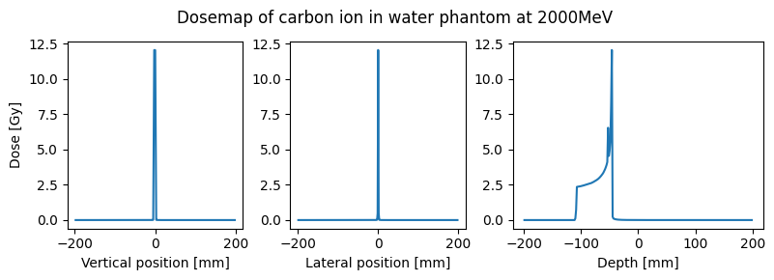
Conditional GAN
(Mirza & Osindero, 2014)
Condition the network with additional information during training.
Generate images of specific input.
Beam characteristic as conditional input
material density matrix of phantom
3D energy deposition of the carbon ion beam
in a water phantom ➔ beam energy
Figure 11 Profiles of the calculated dose distribution of carbon ion in water along three directions.
Notes:
Conditional GAN (cGAN) allows us to condition the network with additional information such as class labels. It means that during the training, we pass images to the network with their actual labels for it to learn the difference between them. That way, we gain the ability to ask our model to generate images of specific input.
3D energy depositions within a pure water phantom provides crucial information about properties of the beam, including its energy and depth-dose profile. This data offered neural network information about the beam's interaction with a default material, presented in the same format as the brain simulation. Utilizing this knowledge could enhance the model's capability to learn.

Slide 14

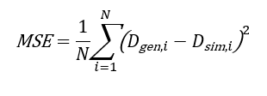
Performance measurement of the generator
Voxel-wise similarity or accuracy of dose predictions is a primary concern.
(Mentzel et al., 2022)
1 ) Delta index
Passing rate = fraction of the voxels with a delta index smaller than 1% or 3%
Choose the model that maximizes the 1%, 3% passing rate
2) Mean Squared Error (MSE)
Measure the difference in every voxel
Choose the model that minimize MSE
Notes:
Voxel-wise similarity or accuracy of dose predictions is a primary concern.
delta was used in Mentzel
The delta index is calculated for each voxel . Passing rate….
However, it was found that the model could predict almost all the voxels with near zero value correctly, which were the majority information. Therefore, the passing rate of the delta criterion tended to be high from early training iterations. The interpretation of this value only could be misleading.
the Mean Squared Error (MSE) was chosen to measure the difference between the generated and simulated dose in every voxel, making it easier to interpret in the context of voxel-level tasks.
The MSE is calculated using the following formula:
The MSE loss is monitored during training to ensure that it is decreasing over time.

Slide 15
Model Training
Wasserstein loss function
Mean Squared Error (MSE), delta index as the evaluation metric
GPU Acceleration
"train-validation-test split" method
Hyperparameters :
Generator learning rate
critic learning rate
(lambda) gradient penalty of Wasserstein loss
critic iteration
optimizer
Notes:
The model was compiled using the Wasserstein loss function and the Mean Squared Error (MSE) was employed as the evaluation metric.
Training was conducted in a GPU-accelerated environment to speed up convergence and use parallel processing capabilities.
The "train-validation-test split" method was employed for hyperparameter tuning and model evaluation. The validation set serves as the basis for comparing various hyperparameter configurations and choosing the most effective one. However, after identifying the optimal hyperparameters, the model underwent retraining using both the training and validation sets.

Slide 16
Results

Slide 17
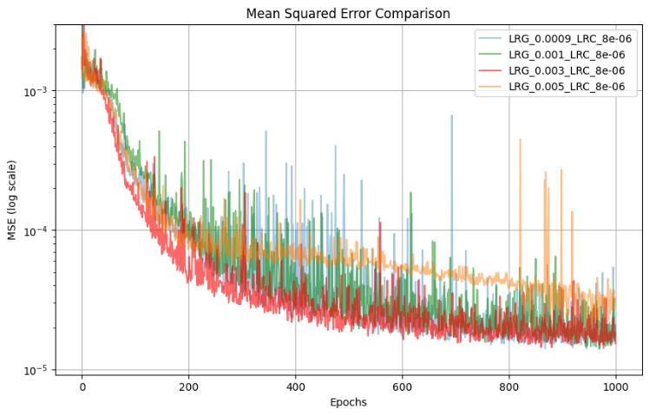
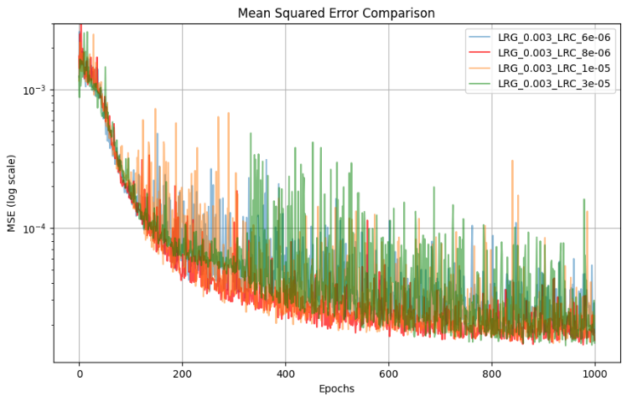
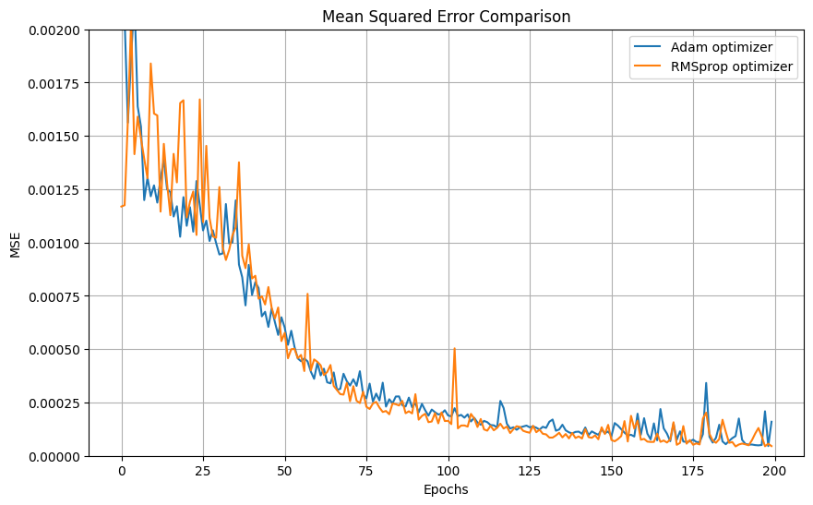
Hyperparameter Tuning
The optimizer RMSprop, generator learning rate = 0.003, critic learning rate = 8E-06, Lambda = 10, and 5 critic iterations showed the best performance for convergence on the validation set.
Figure 12 Performance comparison between different learning rates: varying generator learning rates (left) and varying critic learning rates (right)
Figure 13 Comparison between Adam and RMSprop optimizers.
Notes:
Extensive experiments were conducted to find the best performance for convergence on the validation set.
The optimizer RMSprop with a generator learning rate of 0.003, a critic learning rate of eight times ten to the minus six, a Lambda of 10, and 5 critic iterations showed the best performance .

Slide 18
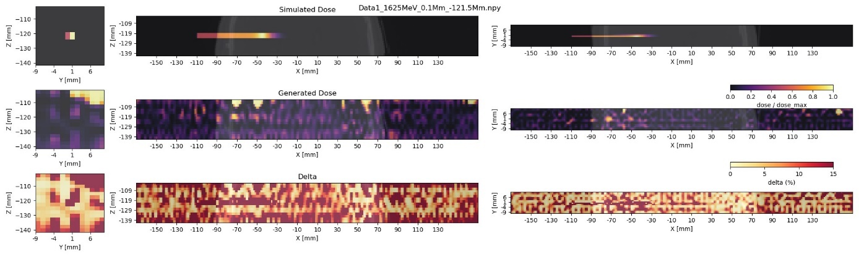
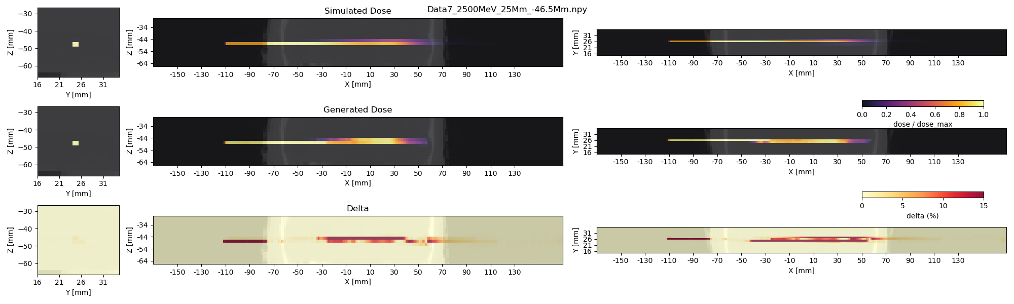
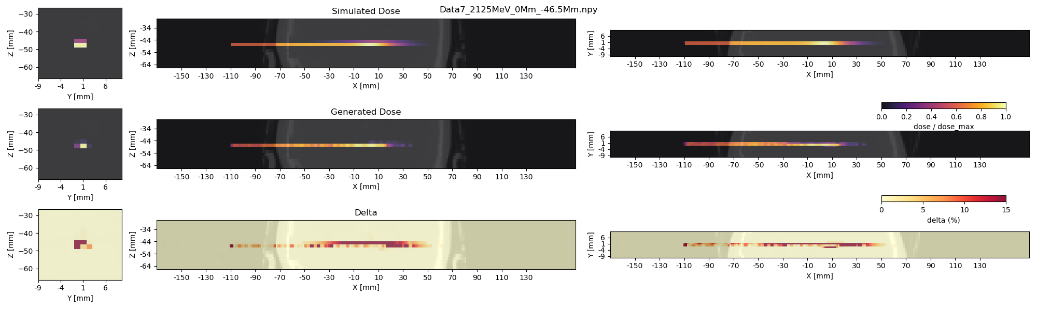
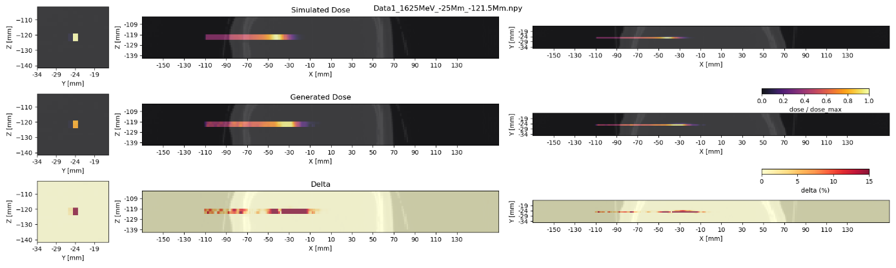
Model’s learning capability
Figure 14 Heat maps representing sample simulated dose distribution (top), generated dose distribution (middle), and their delta (bottom) in three orthogonal planes
a) Training epoch = 1
b) Training epoch = 50
c) Training epoch = 100
d) Training epoch = 150
Notes:
The figure shows samples in the form of heat maps representing the simulated dose, generated dose, and their delta in three orthogonal planes. Within the first initial hundred training epochs, the model demonstrates an improved ability to predict dose distributions that closely align with the ground truth. This suggests a strong learning capability of the model based on the input data. Beyond five hundred training epochs, the model consistently produced dose prediction results that are deemed satisfactory.
: YZ plane (left), XZ plane (middle), and XY plane (right). X axis corresponds to beam direction. YZ plane was plotted at the x-value of maximum dose, indicating the probable location of the Bragg peak.

Slide 19
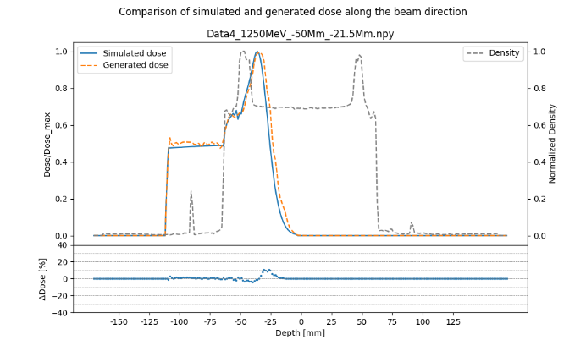
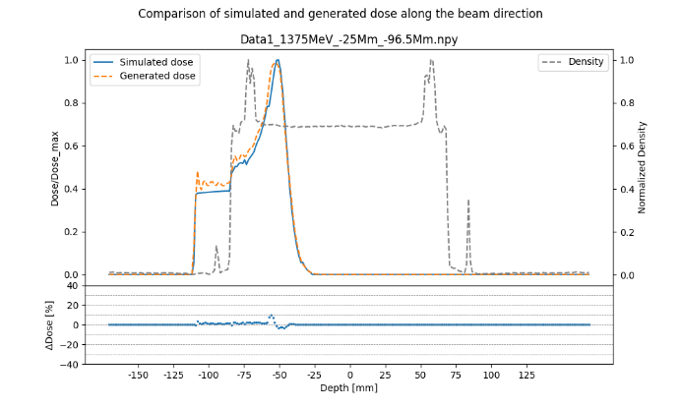
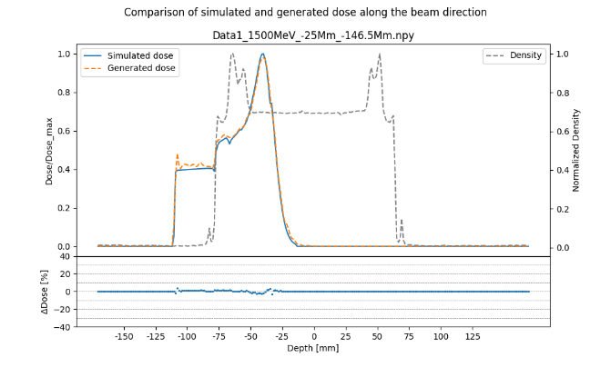
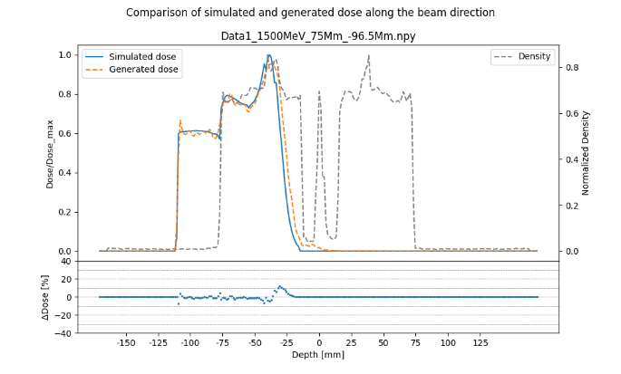
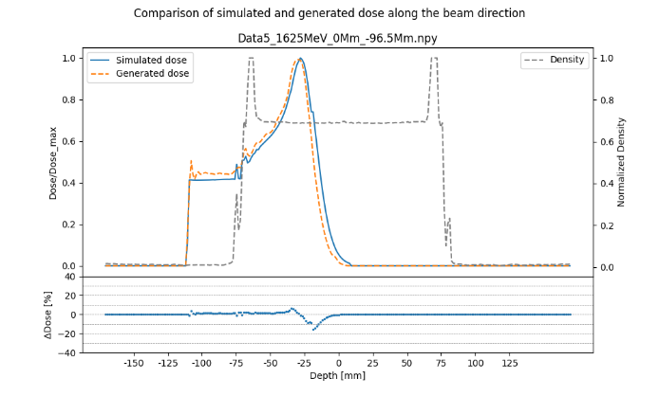
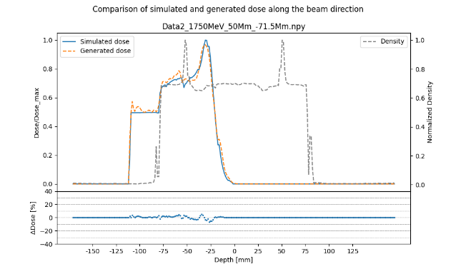
Generated dose distribution
Figure 15 Samples of prediction outcomes from the best model using the test dataset. Comparison between the MC simulated dose (blue) and the generated dose from GAN model (orange) is shown for different beam energies.
Notes:
These plots presents random samples of prediction outcomes from the model using the test dataset. Comparison between the MC simulated dose and the generated dose from the GAN model is shown for various carbon beam energy. The plot shows dose distribution at the center of the beam in the beam direction, revealing a distinct Bragg peak within the head region. The relative deviations between simulated and generated dose are mostly within 10% and the model shows a good ability to interpolate to test dataset.

Slide 20
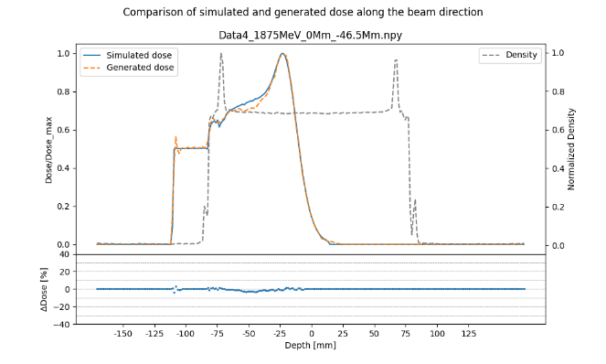
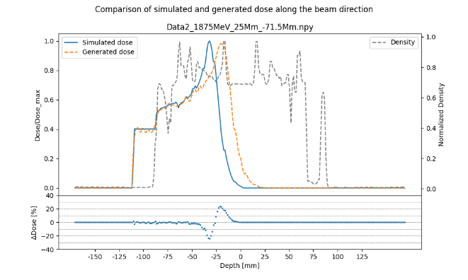
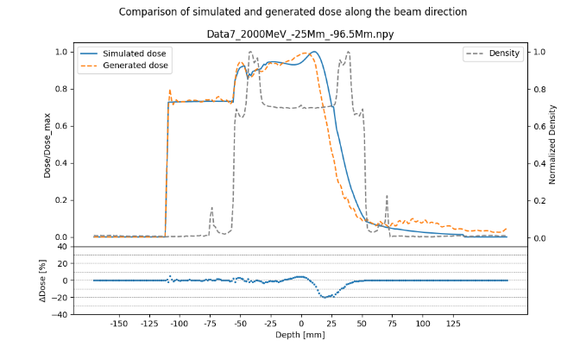
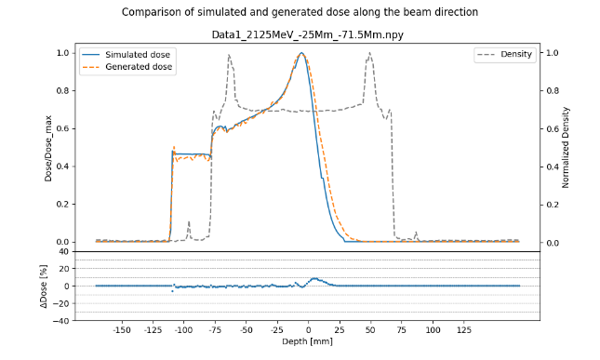
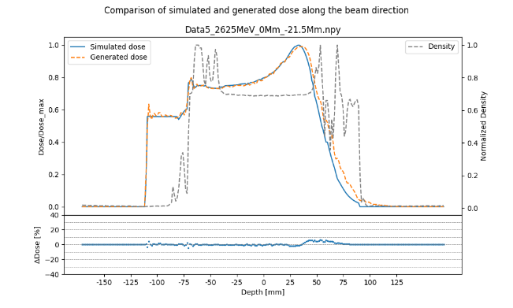
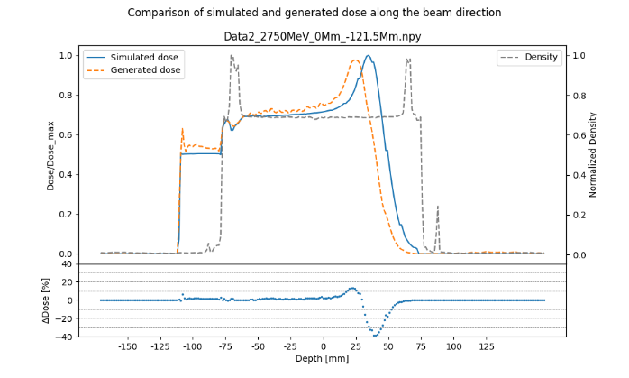
Generated dose distribution (2)
Figure 15 Samples of prediction outcomes from the best model using the test dataset. Comparison between the MC simulated dose (blue) and the generated dose from GAN model (orange) is shown for different beam energies.
Notes:
In cases where there is more occurrence of density transition regions, the model exhibits poor performance, with deviations exceeding 10% (f). It is noted that the deviation is more noticeable in high-energy scenarios than in low-energy scenarios, particularly when the Bragg peak extends deeper into the head region.

Slide 21
Performance
Achievement in MSE and passing rates
Effectiveness in capturing and generalizing patterns from the data
Challenges with the unseen geometry
Table 1 Assessing model performance on validation and test datasets.
Table 2 Time per prediction by GAN model
Notes:
Table presents performance metrics for the model evaluated on both the validation and test datasets as well as the unseen geometry. This shows achievement in MSE and passing rates when tested with the test dataset. The model is effective in capturing and generalizing patterns from the data. However, the model faces challenges with the unseen geometry as conditional input, leading to a significantly higher MSE.
Lastly, the time required for one dose prediction using Geant4 ranged from 1 to 3 hours, depending on the beam energy. For the trained GAN model, the average computational time per prediction was 12 milliseconds on a CPU and 9 milliseconds on a GPU.

Slide 22
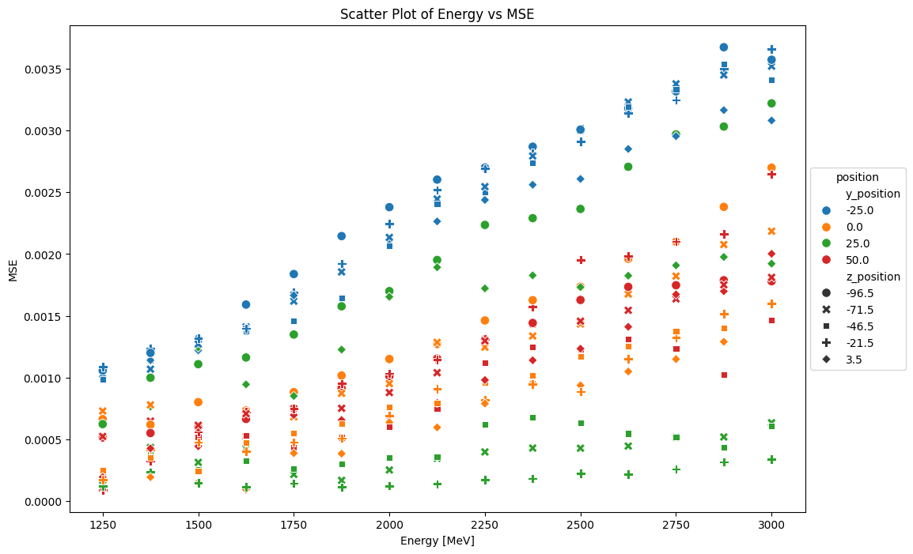
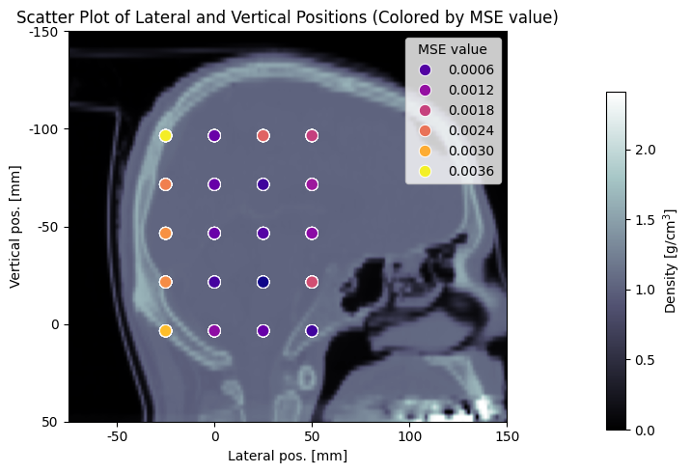
Generalization
Figure 16 Average MSE at different source positions when tested with the test dataset.
Figure 17 Average MSE trends across energy levels and beam positions. Lateral positions are color-coded and vertical positions are symbol-coded.
Notes:
To explore the generalization capability of the trained model, the performance on a held-out test dataset is shown in Figure 16. It displays the MSE for all source positions in the head , overlayed to the geometry slice image. The highest MSE values are found when the beam traverses the skull or propagates close to it, while the lowest values are found when the beam is in the inner part of the brain. However, exceptions can also be seen.
When plotting the MSE for beam energies ranging from 1250 MeV to 3000 MeV, The trend can be observed to be dependent on the beam energy. The MSE values are also influenced by the lateral and vertical positions of the beam source.
This discrepancy arose when dealing with the unseen geometry of an individual patient, as opposed to the test dataset, which comprised five patients encountered during the training phase. To address this, examining the characteristics of the unseen geometry to identify what sets it apart from the other test datasets would be beneficial but was beyond the scope of this work.

Slide 23
Outlook
Potential for future improvements
Considering additional performance metrics ex. Fréchet Inception Distance (FID) ➔ model's performance on the unseen geometry.
Dependencies of MSE on beam energies and source positions ➔ fine-tuning of the model and improve its accuracy
More datasets ➔ employing techniques such as leave-one-patient-out cross-validation
Notes:
There are still potential for improvement.
Considering additional performance metrics will give better understanding of the model's performance on the unseen geometry. For instance, even if the overall dose distribution appears similar, a slight shift of one voxel due to this error may lead to a high MSE. In such cases, one can in future also consider other performance metrics, like the Fréchet Inception Distance (FID), to measure the similarity between real and generated images.
The identified dependencies of MSE on beam energies and source positions suggested promising avenues for future exploration. Examining the underlying mechanisms and dependencies could help with the fine-tuning of the model and improve its accuracy.
Moreover, obtaining more datasets from additional patients or different geometries for training and testing the model. The training process could benefit from employing techniques such as leave-one-patient-out cross-validation to enhance the robustness and generalization capabilities of the model.

Slide 24
Conclusion

Slide 25

Conclusion
Proof-of-concept exploration into accelerating dose distribution calculations in carbon ion radiation therapy through a WGAN.
Utilized simulated dose maps from Geant4 simulations of carbon ion beams in the human brain and in water.
"train-validation-test split" for hyperparameter tuning and model evaluation.
Millisecond per dose calculation.
It successfully predicted dose distributions with high accuracy: > 99% passing rate in all cases.
Accelerated dose calculation
Accurate dose calculation
Notes:
This master thesis served as a proof-of-concept exploration into accelerating dose distribution calculations in carbon ion radiation therapy through a Wasserstein Generative Adversarial Network (WGAN).
The training of the network utilized simulated dose maps from Geant4 simulations of carbon ion beams in the human brain and in water.
The "train-validation-test split" method was employed for hyperparameter tuning and model evaluation.
It achieved a five-orders-of-magnitude reduction in dose calculation time compared to Geant4 simulations.
.It successfully predicted dose distributions with high accuracy on the test dataset, producing greater than 99% passing rate in all cases. The result aligned with the objectives of this study.

Slide 26
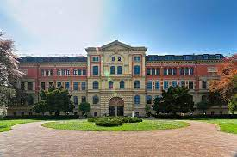


Acknowledgments
AAPM Report 85. (2004). Tissue inhomogeneity corrections for megavoltage photon beams. Radiation Therapy Committee Task Group 65. Medical Physics Publishing, Madison, WI. https://www.aapm.org/pubs/reports/rpt_85.pdf
Andreo, P., Burns, D. T., Nahum, A. E., Seuntjens, J., & Attix, F. H. (2017). Fundamentals of ionizing radiation dosimetry. Textbook / Pedro Andreo, David T. Burns, Alan E. Nahum, Jan Seuntjens, and Frank H. Attix. Wiley-VCH.
Arjovsky, M., & Bottou, L. (2017). Towards Principled Methods for Training Generative Adversarial Networks (arXiv:1701.04862). arXiv. http://arxiv.org/abs/1701.04862
Arjovsky, M., Chintala, S., & Bottou, L. (2017). Wasserstein GAN (arXiv:1701.07875). arXiv. http://arxiv.org/abs/1701.07875
Barragán-Montero, A. M., Thomas, M., Defraene, G., Michiels, S., Haustermans, K., Lee, J. A., & Sterpin, E. (2021). Deep learning dose prediction for IMRT of esophageal cancer: The effect of data quality and quantity on model performance. Physica Medica, 83, 52–63. https://doi.org/10.1016/j.ejmp.2021.02.026
Bert, J., Perez-Ponce, H., Bitar, Z. E., Jan, S., Boursier, Y., Vintache, D., Bonissent, A., Morel, C., Brasse, D., & Visvikis, D. (2013). Geant4-based Monte Carlo simulations on GPU for medical applications. Physics in Medicine and Biology, 58(16), 5593–5611. https://doi.org/10.1088/0031-9155/58/16/5593
Goodfellow, I. J., Pouget-Abadie, J., Mirza, M., Xu, B., Warde-Farley, D., Ozair, S., Courville, A., & Bengio, Y. (2014). Generative Adversarial Networks (arXiv:1406.2661). arXiv. http://arxiv.org/abs/1406.2661
Gulrajani, I., Ahmed, F., Arjovsky, M., Dumoulin, V., & Courville, A. (2017). Improved Training of Wasserstein GANs (arXiv:1704.00028). arXiv. http://arxiv.org/abs/1704.00028
Jermann, M. (2016). PTCOG. https://www.ptcog.site/index.php/patient-statistics-2
Kearney, V., Chan, J. W., Wang, T., Perry, A., Descovich, M., Morin, O., Yom, S. S., & Solberg, T. D. (2020). DoseGAN: A generative adversarial network for synthetic dose prediction using attention-gated discrimination and generation. Scientific Reports, 10(1), 11073. https://doi.org/10.1038/s41598-020-68062-7
Lan, L., You, L., Zhang, Z., Fan, Z., Zhao, W., Zeng, N., Chen, Y., & Zhou, X. (2020). Generative Adversarial Networks and Its Applications in Biomedical Informatics. Frontiers in Public Health, 8, 164. https://doi.org/10.3389/fpubh.2020.00164
Mentzel, F., Kröninger, K., Lerch, M., Nackenhorst, O., Paino, J., Rosenfeld, A., Saraswati, A., Tsoi, A. C., Weingarten, J., Hagenbuchner, M., & Guatelli, S. (2022). Fast and accurate dose predictions for novel radiotherapy treatments in heterogeneous phantoms using conditional 3D‐UNet generative adversarial networks. Medical Physics, 49(5), 3389–3404. https://doi.org/10.1002/mp.15555
Mirza, M., & Osindero, S. (2014). Conditional Generative Adversarial Nets (arXiv:1411.1784). arXiv. http://arxiv.org/abs/1411.1784
Nguyen, D., Long, T., Jia, X., Lu, W., Gu, X., Iqbal, Z., & Jiang, S. (2019). A feasibility study for predicting optimal radiation therapy dose distributions of prostate cancer patients from patient anatomy using deep learning. Scientific Reports, 9(1), 1076. https://doi.org/10.1038/s41598-018-37741-x
Pamisa, D. R., Convicto, V., Lintasan, A., & Quiñones, C. T. (2020). Monte Carlo Investigation of the Depth-dose Profile of Proton Beams and Carbon Ions in Water, Skeletal Muscle, Adipose Tissue, and Cortical Bone for Hadron Therapy Applications. Journal of Physics: Conference Series, 1505(1), 012010. https://doi.org/10.1088/1742-6596/1505/1/012010
Radford, A., Metz, L., & Chintala, S. (2016). Unsupervised Representation Learning with Deep Convolutional Generative Adversarial Networks (arXiv:1511.06434). arXiv. http://arxiv.org/abs/1511.06434
Salimans, T., Goodfellow, I., Zaremba, W., Cheung, V., Radford, A., & Chen, X. (2016). Improved Techniques for Training GANs (arXiv:1606.03498). arXiv. http://arxiv.org/abs/1606.03498
Sarrut, D., Krah, N., & Létang, J.-M. (2019). Generative Adversarial Networks (GAN) for compact beam source modelling in Monte Carlo simulations. https://doi.org/10.48550/ARXIV.1907.13324
Schwarze, M. (2023). MC Simulation of a therapeutic carbon ion beam in head. https://gitlab1.ptb.de/MiriamSchwarze/simudosemapheavyions
Seco, J., & Verhaegen, F. (Eds.). (2016). Monte Carlo Techniques in Radiation Therapy (0 ed.). CRC Press. https://doi.org/10.1201/b13961
Seltzer, S. M., Bartlett, D. T., Burns, D. T., Dietze, G., Menzel, H.-G., Paretzke, H. G., & Wambersie, A. (2011). 5. Dosimetry. Journal of the ICRU, 11(1), 23–28. https://doi.org/10.1093/jicru/ndr003
Shusharina, N., & Bortfeld, T. (2021). Glioma Image Segmentation for Radiotherapy: RT targets, barriers to cancer spread, and organs at risk (GLIS-RT) (Version 1) [dataset]. The Cancer Imaging Archive. https://doi.org/10.7937/TCIA.T905-ZQ20
Tsujii, H. (2017). Overview of Carbon-ion Radiotherapy. Journal of Physics: Conference Series, 777, 012032. https://doi.org/10.1088/1742-6596/777/1/012032
Vassiliev, O. N. (2016). Monte Carlo methods for radiation transport: Fundamentals and advanced topics. Springer Science+Business Media.
Weng, L. (2019). From GAN to WGAN (arXiv:1904.08994). arXiv. http://arxiv.org/abs/1904.08994
Yoganathan, S. A., & Zhang, R. (2019). An atlas-based method to predict three-dimensional dose distributions for cancer patients who receive radiotherapy. Physics in Medicine & Biology, 64(8), 085016. https://doi.org/10.1088/1361-6560/ab10a0
Zhang, Q., Kong, L., Liu, R., & Wang, X. (2021). Ion therapy guideline (Version 2020): Radiation Oncology Physicians Branch of Chinese Medical Doctor Association. Precision Radiation Oncology, 5(2), 73–83. https://doi.org/10.1002/pro6.1120
Hochschule Anhalt
Prof. Dr. Marianne Maktabi
Physikalisch-Technische Bundesanstalt Berlin
Abteilung 8.01
Dr. Hans Rabus
Leo Thomas
Miriam Schwarze
HPC
Florian Burger

Slide 27
References
AAPM Report 85. (2004). Tissue inhomogeneity corrections for megavoltage photon beams. Radiation Therapy Committee Task Group 65. Medical Physics Publishing, Madison, WI. https://www.aapm.org/pubs/reports/rpt_85.pdf
Agostinelli, S., Allison, J., Amako, K., Apostolakis, J., Araujo, H., Arce, P., Asai, M., Axen, D., Banerjee, S., Barrand, G., Behner, F., Bellagamba, L., Boudreau, J., Broglia, L., Brunengo, A., Burkhardt, H., Chauvie, S., Chuma, J., Chytracek, R., … Zschiesche, D. (2003). Geant4—A simulation toolkit. Nuclear Instruments and Methods in Physics Research Section A: Accelerators, Spectrometers, Detectors and Associated Equipment, 506(3), 250–303. https://doi.org/10.1016/S0168-9002(03)01368-8
Andreo, P., Burns, D. T., Nahum, A. E., Seuntjens, J., & Attix, F. H. (2017). Fundamentals of ionizing radiation dosimetry. Textbook / Pedro Andreo, David T. Burns, Alan E. Nahum, Jan Seuntjens, and Frank H. Attix. Wiley-VCH.
Arjovsky, M., & Bottou, L. (2017). Towards Principled Methods for Training Generative Adversarial Networks (arXiv:1701.04862). arXiv. http://arxiv.org/abs/1701.04862
Arjovsky, M., Chintala, S., & Bottou, L. (2017). Wasserstein GAN (arXiv:1701.07875). arXiv. http://arxiv.org/abs/1701.07875
Barragán-Montero, A. M., Thomas, M., Defraene, G., Michiels, S., Haustermans, K., Lee, J. A., & Sterpin, E. (2021). Deep learning dose prediction for IMRT of esophageal cancer: The effect of data quality and quantity on model performance. Physica Medica, 83, 52–63. https://doi.org/10.1016/j.ejmp.2021.02.026
Bert, J., Perez-Ponce, H., Bitar, Z. E., Jan, S., Boursier, Y., Vintache, D., Bonissent, A., Morel, C., Brasse, D., & Visvikis, D. (2013). Geant4-based Monte Carlo simulations on GPU for medical applications. Physics in Medicine and Biology, 58(16), 5593–5611. https://doi.org/10.1088/0031-9155/58/16/5593
Douglass, M. J. J. (2020). Book Review: Hands-on Machine Learning with Scikit-Learn, Keras, and Tensorflow, 2nd edition by Aurélien Géron: O’ Reilly Media, 2019, 600 pp., ISBN: 978-1-492-03264-9. Physical and Engineering Sciences in Medicine, 43(3), 1135–1136. https://doi.org/10.1007/s13246-020-00913-z
Goodfellow, I. J., Pouget-Abadie, J., Mirza, M., Xu, B., Warde-Farley, D., Ozair, S., Courville, A., & Bengio, Y. (2014). Generative Adversarial Networks (arXiv:1406.2661). arXiv. http://arxiv.org/abs/1406.2661

Slide 28
References
Gulrajani, I., Ahmed, F., Arjovsky, M., Dumoulin, V., & Courville, A. (2017). Improved Training of Wasserstein GANs (arXiv:1704.00028). arXiv. http://arxiv.org/abs/1704.00028
Jermann, M. (2016). PTCOG. https://www.ptcog.site/index.php/patient-statistics-2
Kearney, V., Chan, J. W., Wang, T., Perry, A., Descovich, M., Morin, O., Yom, S. S., & Solberg, T. D. (2020). DoseGAN: A generative adversarial network for synthetic dose prediction using attention-gated discrimination and generation. Scientific Reports, 10(1), 11073. https://doi.org/10.1038/s41598-020-68062-7
Lan, L., You, L., Zhang, Z., Fan, Z., Zhao, W., Zeng, N., Chen, Y., & Zhou, X. (2020). Generative Adversarial Networks and Its Applications in Biomedical Informatics. Frontiers in Public Health, 8, 164. https://doi.org/10.3389/fpubh.2020.00164
Mentzel, F., Kröninger, K., Lerch, M., Nackenhorst, O., Paino, J., Rosenfeld, A., Saraswati, A., Tsoi, A. C., Weingarten, J., Hagenbuchner, M., & Guatelli, S. (2022). Fast and accurate dose predictions for novel radiotherapy treatments in heterogeneous phantoms using conditional 3D‐UNet generative adversarial networks. Medical Physics, 49(5), 3389–3404. https://doi.org/10.1002/mp.15555
Mirza, M., & Osindero, S. (2014). Conditional Generative Adversarial Nets (arXiv:1411.1784). arXiv. http://arxiv.org/abs/1411.1784
Nguyen, D., Long, T., Jia, X., Lu, W., Gu, X., Iqbal, Z., & Jiang, S. (2019). A feasibility study for predicting optimal radiation therapy dose distributions of prostate cancer patients from patient anatomy using deep learning. Scientific Reports, 9(1), 1076. https://doi.org/10.1038/s41598-018-37741-x
Radford, A., Metz, L., & Chintala, S. (2016). Unsupervised Representation Learning with Deep Convolutional Generative Adversarial Networks (arXiv:1511.06434). arXiv. http://arxiv.org/abs/1511.06434
Russell, S. J., & Norvig, P. (2010). Artificial Intelligence A Modern Approach (3rd ed.). Pearson Education, Inc.
Salimans, T., Goodfellow, I., Zaremba, W., Cheung, V., Radford, A., & Chen, X. (2016). Improved Techniques for Training GANs (arXiv:1606.03498). arXiv. http://arxiv.org/abs/1606.03498

Slide 29
References
Sarrut, D., Krah, N., & Létang, J.-M. (2019). Generative Adversarial Networks (GAN) for compact beam source modelling in Monte Carlo simulations. https://doi.org/10.48550/ARXIV.1907.13324
Schwarze, M. (2023). MC Simulation of a therapeutic carbon ion beam in head. https://gitlab1.ptb.de/MiriamSchwarze/simudosemapheavyions
Seco, J., & Verhaegen, F. (Eds.). (2016). Monte Carlo Techniques in Radiation Therapy (0 ed.). CRC Press. https://doi.org/10.1201/b13961
Seltzer, S. M., Bartlett, D. T., Burns, D. T., Dietze, G., Menzel, H.-G., Paretzke, H. G., & Wambersie, A. (2011). 5. Dosimetry. Journal of the ICRU, 11(1), 23–28. https://doi.org/10.1093/jicru/ndr003
Shanmugamani, R. (2018). Deep Learning for Computer Vision: Expert techniques to train advanced neural networks using TensorFlow and Keras (1st ed.). Packt Publishing Ltd.
Shusharina, N., & Bortfeld, T. (2021). Glioma Image Segmentation for Radiotherapy: RT targets, barriers to cancer spread, and organs at risk (GLIS-RT) (Version 1) [dataset]. The Cancer Imaging Archive. https://doi.org/10.7937/TCIA.T905-ZQ20
Tsujii, H. (2017). Overview of Carbon-ion Radiotherapy. Journal of Physics: Conference Series, 777, 012032. https://doi.org/10.1088/1742-6596/777/1/012032
Vassiliev, O. N. (2016). Monte Carlo methods for radiation transport: Fundamentals and advanced topics. Springer Science+Business Media.
Weng, L. (2019). From GAN to WGAN (arXiv:1904.08994). arXiv. http://arxiv.org/abs/1904.08994
Yoganathan, S. A., & Zhang, R. (2019). An atlas-based method to predict three-dimensional dose distributions for cancer patients who receive radiotherapy. Physics in Medicine & Biology, 64(8), 085016. https://doi.org/10.1088/1361-6560/ab10a0
Zhang, Q., Kong, L., Liu, R., & Wang, X. (2021). Ion therapy guideline (Version 2020): Radiation Oncology Physicians Branch of Chinese Medical Doctor Association. Precision Radiation Oncology, 5(2), 73–83. https://doi.org/10.1002/pro6.1120

Slide 30
Thank you for your attention . . .

